Slide 1
Customer Booking Prediction Model for British Airways
By Sneha Murali

Slide 2
Objective
To develop a predictive model that identifies the likelihood of a customer completing a flight booking, using historical behavioral and transactional data.

Slide 3
Methodology
Data Exploration: Reviewed structure, cleaned missing values, and understood variable types.
Feature Engineering: Encoded categorical features, and created a clean dataset ready for modeling.
Model Training: Used a Random Forest Classifier due to its robustness and ability to rank feature importance.
Model Evaluation: Applied an 80/20 train-test split and evaluated using accuracy, precision, recall, and F1-score.

Slide 4
Key Insights
Purchase lead time is the strongest predictor of booking completion.
Flight hour and length of stay significantly influence booking behavior.
More passengers per booking increases completion likelihood.
Flight duration moderately impacts booking success.
Preferences for in-flight meals and extra services also affect decisions.

Slide 5
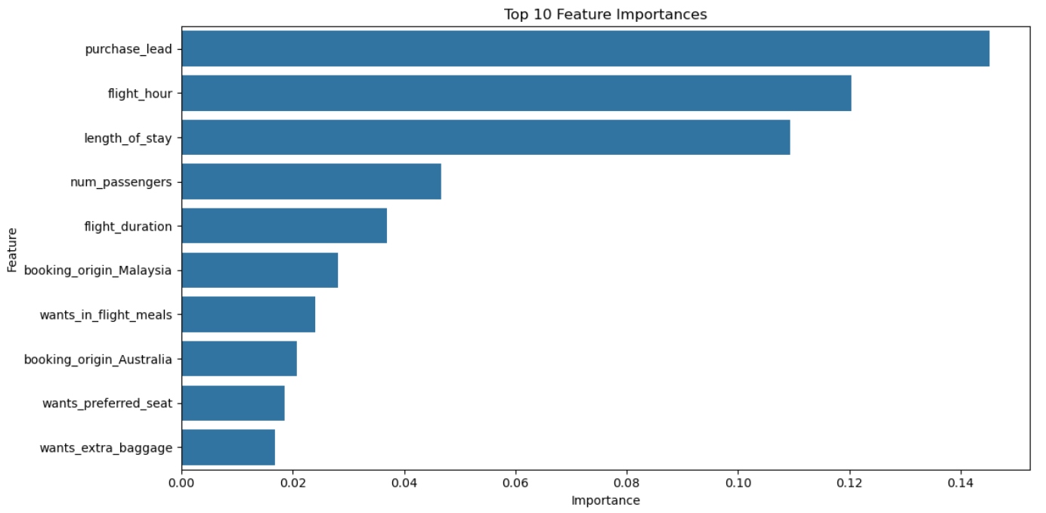
Visualizations

Slide 6
Conclusion
The predictive model reliably identifies likely bookings, offering actionable insights to optimize customer targeting and marketing efforts. These findings can help improve conversion rates and personalize offers based on customer preferences.

